Slide 1

Secure Online Transactions with Dual OTP Authentication
Adarsh S 21BRS1301
M R Madhavan 21BRS1433
Adarsh K M 21BRS1158
Guide : Dr. Kalaivanan K

Slide 2
Introduction
In the digital era, online financial transactions have become increasingly common, but they are often vulnerable to fraud and unauthorized access. Traditional authentication methods, such as passwords or OTPs, fail to provide comprehensive security, as they can be intercepted or misused. To address these challenges, the Dual OTP and Fingerprint-Based Two-Step Authentication System offers a novel solution by integrating multi-factor authentication to ensure robust transaction security. This system combines OTP verification with fingerprint-based biometric validation, requiring both the sender and receiver to authenticate their identities through a dual-layer process. By mapping OTP digits to specific fingerprints, the system ensures that each transaction is uniquely secure and prevents unauthorized access even if the OTP is compromised. Designed with a user-friendly interface and advanced technologies, this system strengthens online security, reduces fraud risks, and builds trust in digital financial services by ensuring the authenticity of all participants.

Slide 3
Problem Statement
Reliance on online financial transactions increases convenience but exposes users to serious security risks. Traditional authentication methods like passwords or single-factor OTPs are vulnerable to cyber threats including phishing, interception, and identity theft, often failing to ensure stronger protection, and thus allowing fraudulent activities and financial losses leading to users losing confidence in the digital banking system. A major limitation of current systems is their one-sided focus on authenticating the sender, leaving the receiver’s identity unchecked. This creates vulnerabilities that can be exploited for unauthorized fund transfers or impersonation. Furthermore, relying solely on OTPs or biometric data as standalone solutions leaves room for exploitation, as neither can fully ensure user presence and identity during transactions. To fill up these gaps, a more secure, double-layered authentication mechanism is necessary. The proposed dual OTP and fingerprint-based two-step authentication system will provide a full solution by enabling OTP verification by combining it with the biometric fingerprint matching for both sender and receiver. This system ensures that the parties involved in the transaction are legitimate and authorized, thus lowering fraud risk substantially. With advance security features integration, this system aims to enhance the integrity of modern financial transactions with trust and safety.

Slide 4
Research Objectives
The primary objective is to develop a comprehensive, dual-layered authentication mechanism that verifies both the sender and receiver, ensuring robust security throughout the transaction process. Key Objectives: 1. Strengthen Transaction Security: To combine One-Time Password (OTP) verification with fingerprint-based authentication, creating a multi-factor authentication system that reduces the risk of phishing, interception, and unauthorized access. 2. Dual-Party Verification: To implement a mechanism that authenticates both the sender and receiver, preventing fraud by ensuring that only authorized individuals can initiate and complete transactions. 3. Enhance Usability and Accessibility: To design a user-friendly interface that guides users through the OTP and fingerprint input process, ensuring the system is intuitive and accessible for a wide range of users. 4. Improve System Scalability: To develop an architecture capable of handling large-scale financial transactions, ensuring reliability and adaptability across diverse financial platforms. 5. Establish Real-Time Validation: To integrate real-time data processing and verification algorithms, enabling quick and accurate authentication without compromising user experience.

Slide 5
Proposed System
The Dual OTP and Fingerprint-Based Two-Step Authentication System introduces a robust, multi-layered security framework to enhance the safety of online financial transactions. The proposed system integrates OTP (One-Time Password) verification with fingerprint-based authentication, ensuring dual verification for both the sender and receiver. This innovative approach addresses the vulnerabilities of conventional methods, such as reliance on static passwords or single-layer OTPs, by introducing biometric validation as an additional layer of security. The system generates a unique OTP for every transaction, which is mapped to specific fingerprints using a predefined schema. Users must input the OTP digits while simultaneously verifying each digit with a corresponding fingerprint scan. This dual-layer approach prevents unauthorized access, as both the OTP and fingerprint sequence must match the server's records. The system architecture supports real-time validation through seamless integration of APIs for fingerprint scanning and OTP distribution. A secure database manages the storage of transaction records, user profiles, and biometric data. Additionally, the system employs JPublisher to ensure efficient communication between the database and application logic.

Slide 6
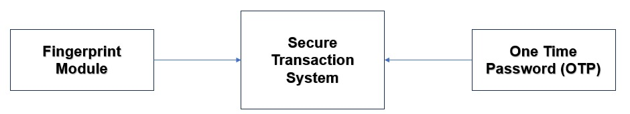
Abstract System Architecture

Slide 7
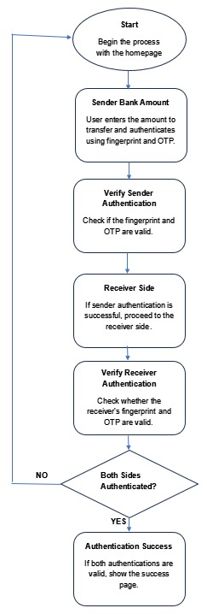
System Workflow

Slide 8
List Of Modules
OTP Generation and Distribution Module Description: Generates one-time passwords (OTPs) for both the sender and receiver to validate transactions. Integration: Integrated with the transaction system to generate OTPs upon transaction initiation, sent securely via SMS or email.
Fingerprint Matching Mechanism Description: Captures and verifies fingerprints against pre-registered data to provide additional authentication. Integration: Uses fingerprint scanners and interfaces with the server for real-time verification of fingerprint data.
Dual Verification Process Module Description: Requires both sender and receiver to authenticate using OTPs and corresponding fingerprints independently. Integration: Works with both the OTP and fingerprint modules to ensure multi-layered verification before transaction approval.
Transaction Authentication Server Module Description: Manages the generation of OTPs, fingerprint validation, and overall transaction verification. Integration: Central server processes both OTP and fingerprint data, authenticating the users and authorizing the transaction.

Slide 9
This module generates one-time passwords (OTPs) to validate online financial transactions. The OTPs are generated upon transaction initiation and securely distributed to both the sender and receiver via SMS or email for verification. Features: Generates unique, time-sensitive OTPs for each transaction. Ensures that both sender and receiver receive separate OTPs for validation. Integration Details: Integrated with the transaction system to trigger OTP generation upon initiating a transaction. OTPs are securely sent through SMS or email using encryption protocols for safe delivery. Benefits: Provides an added layer of security by using dynamic, time-bound passwords. Reduces the risk of unauthorized access or interception during transactions.
OTP Generation and Distribution Module

Slide 10
Fingerprint Matching Mechanism
This module captures and verifies the user's fingerprint against pre-registered data for additional authentication, ensuring that only authorized individuals can complete the transaction.
Features:
Captures biometric fingerprint data for verification.
Compares fingerprint input to pre-registered data stored on the server.
Integration Details:
Uses a fingerprint scanner interface to collect biometric data from the user.
Real-time verification is performed by sending the fingerprint data to the server for comparison with the stored record.
Benefits:
Adds a layer of security through biometric authentication.
Prevents unauthorized access, even if the OTP is compromised.

Slide 11
This module ensures that both the sender and receiver must authenticate using both OTPs and corresponding fingerprints independently, adding a multi-layered security approach to the transaction. Features: Requires both sender and receiver to authenticate using OTP and fingerprint. Ensures independent verification for both parties before completing a transaction. Integration Details: Links OTP and fingerprint validation systems to require independent authentication from both sender and receiver. Coordinates the authentication steps for both parties before allowing the transaction to proceed. Benefits: Increases transaction security by verifying both sender and receiver. Prevents fraudulent transactions by adding multiple layers of authentication.
Dual Verification Process Module

Slide 12
Transaction Authentication Server Module
This module manages the generation of OTPs, fingerprint validation, and overall transaction verification, ensuring that both parties are properly authenticated before a transaction is approved.
Features:
Manages OTP generation, fingerprint matching, and transaction authorization.
Ensures secure and reliable verification of both sender and receiver.
Integration Details:
The central server interfaces with the OTP generation system and fingerprint matching system.
Authenticates both OTP and fingerprint data, authorizing the transaction if all checks pass.
Benefits:
Centralized control for secure transaction validation.
Ensures high-level security by validating both OTP and biometric data before authorizing a transaction.

Slide 13
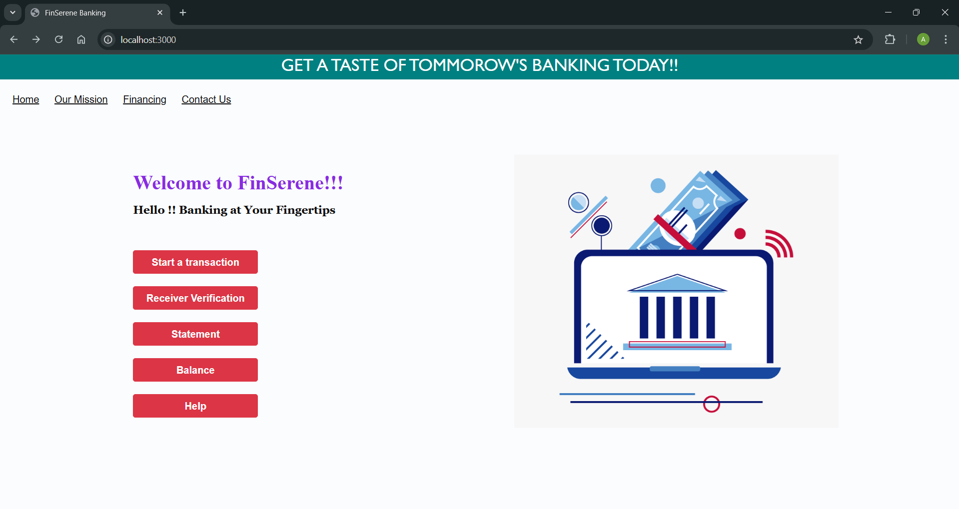
Results:
The sender and the receiver side of the payment portal was setup successfully.
Landing Page

Slide 14
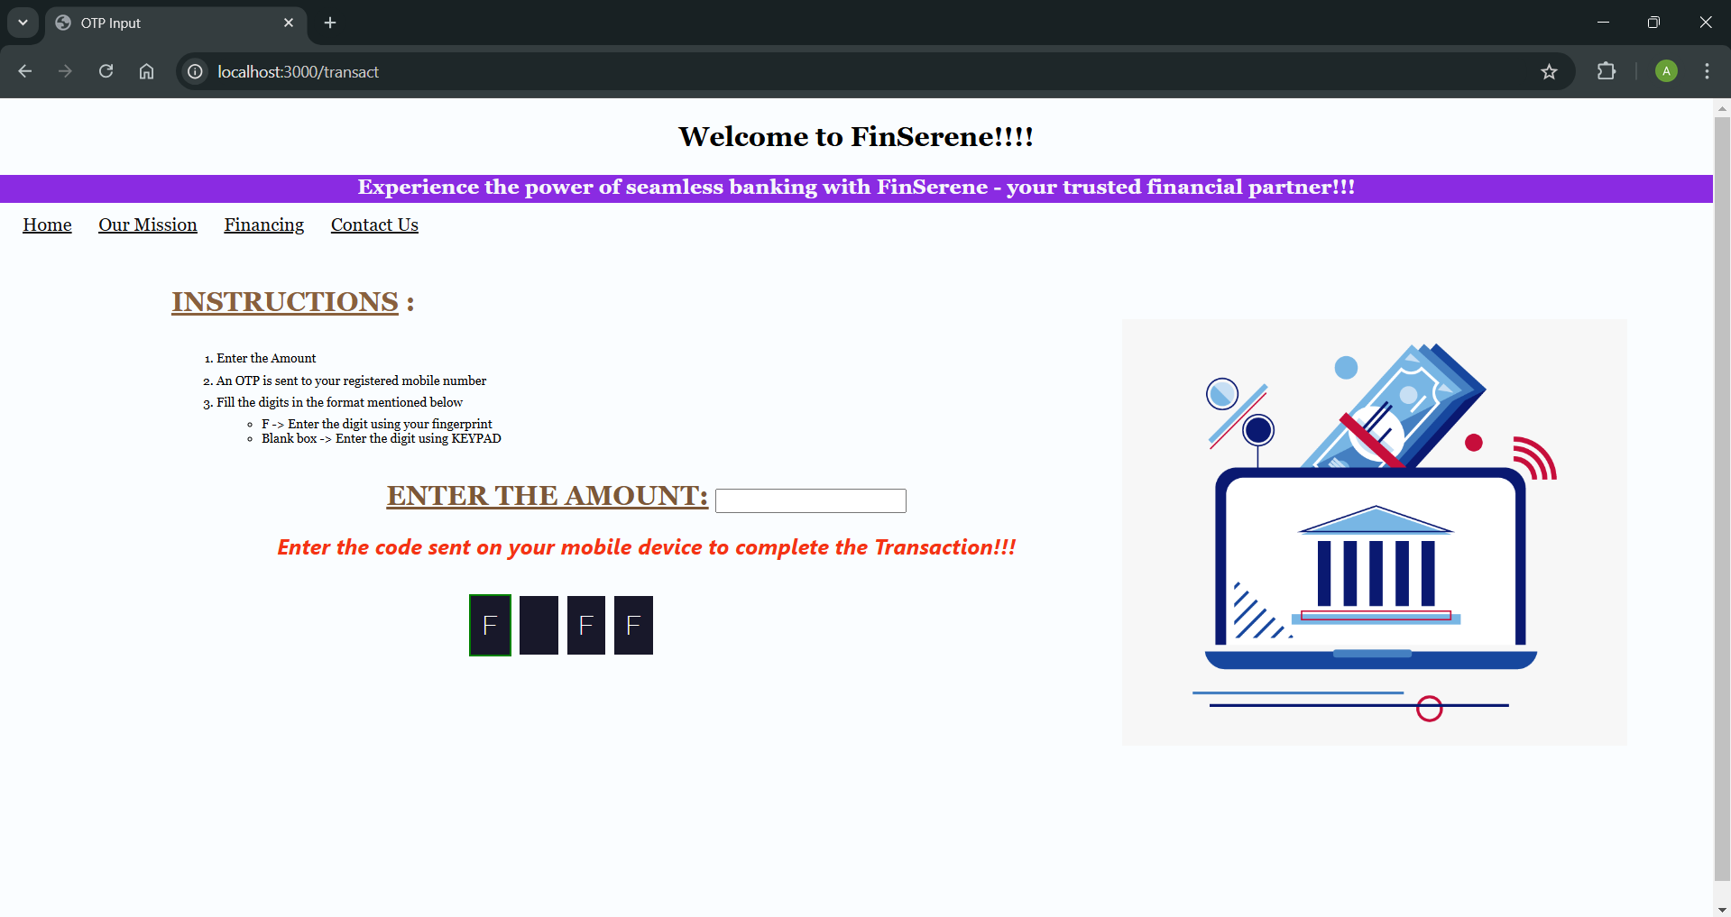
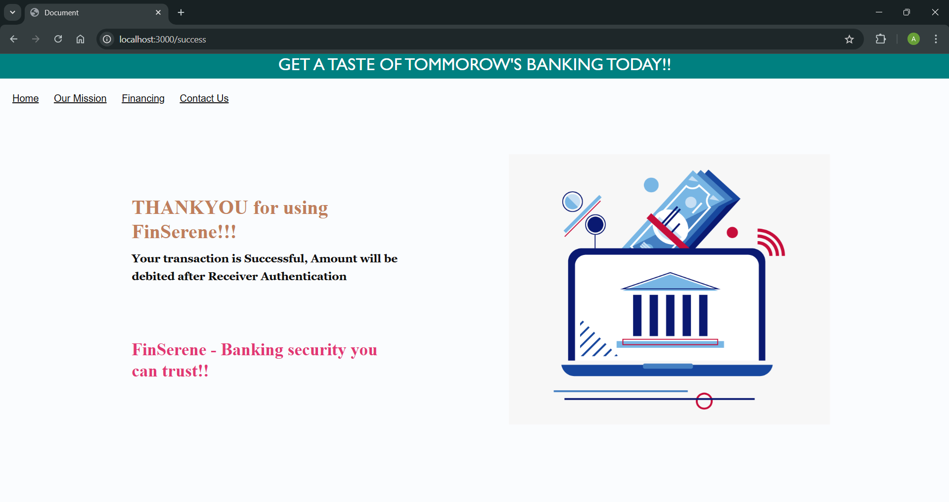
Sender’s Side – After Authentication
Sender’s Side – Before Authentication

Slide 15
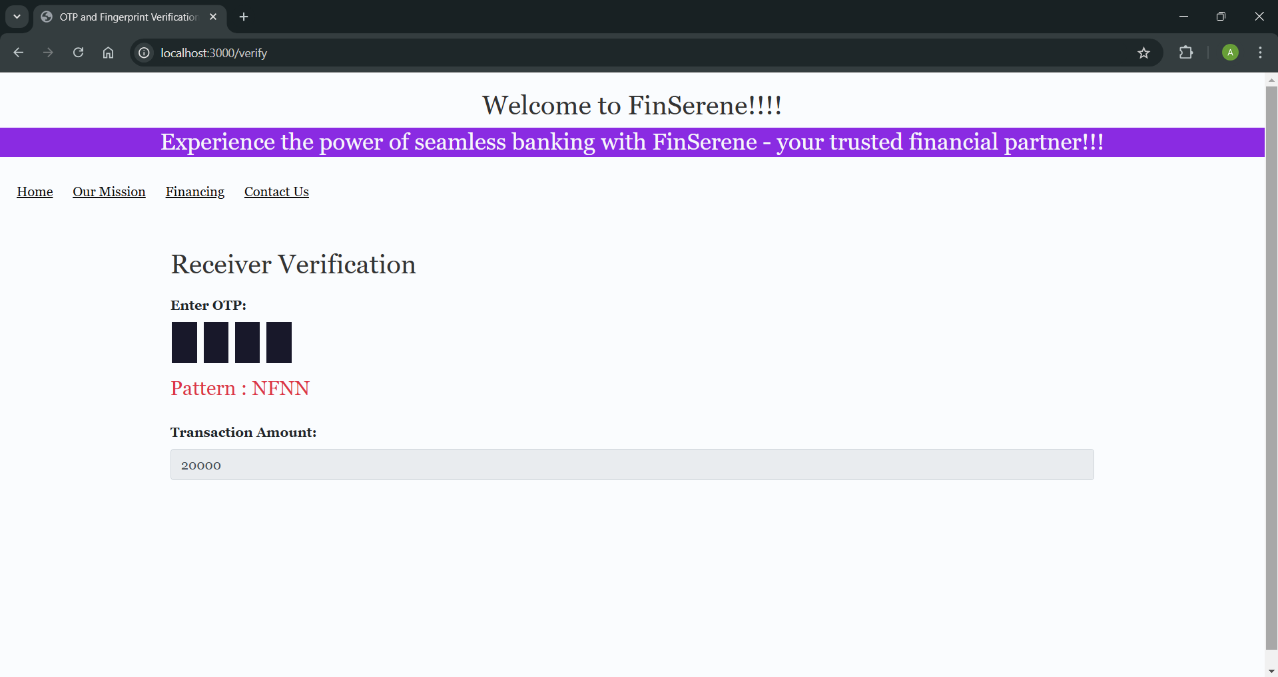
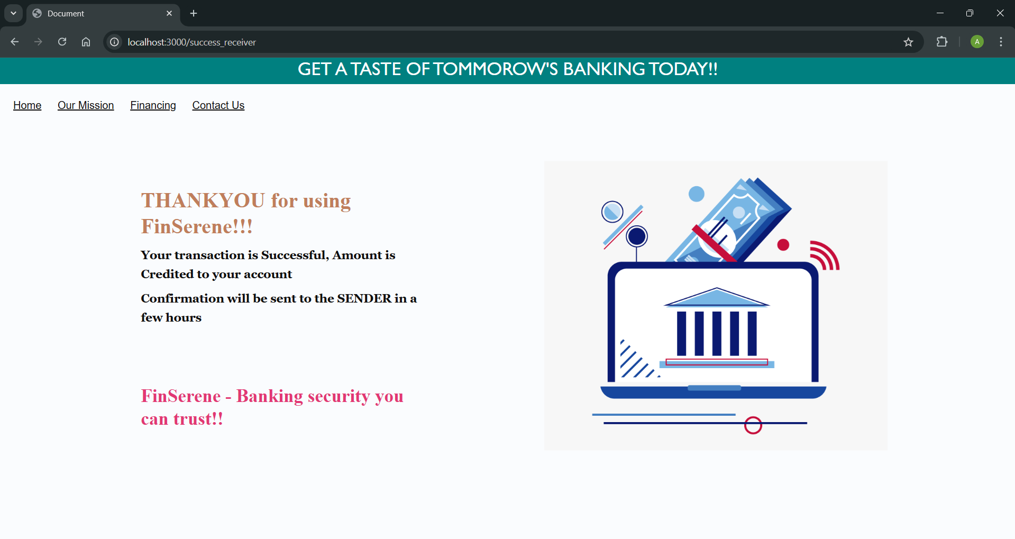
Receiver’s Side – Before Authentication
Receiver’s Side – After Authentication

Slide 16
Conclusion
The dual OTP-based two-step authentication system significantly enhances the security of online financial transactions. By implementing both OTP verification and fingerprint authentication, it provides a robust defense against unauthorized access, identity theft, and other forms of cyber fraud. This system offers a more comprehensive and reliable method of verifying both the sender and receiver of transactions, thus reducing the potential for fraudulent activities and boosting user confidence in digital financial systems. With seamless integration into existing transaction platforms, this solution ensures that security can be easily implemented without disrupting the user experience.
This research and implementation demonstrate the efficacy of multi-layered authentication in improving transaction security. By addressing critical vulnerabilities present in traditional single-layer OTP or password-based systems, it sets a new standard for secure financial transactions in an increasingly digital world.

Slide 17
Future Scope
The dual OTP-based two-step authentication system can be further enhanced and expanded in the following ways:
Integration with Multi-Factor Authentication (MFA): Beyond OTP and fingerprint authentication, integrating additional factors such as facial recognition or voice recognition can further strengthen security, providing a more comprehensive multi-factor authentication system.
Scalability and Adaptability: As the number of digital transactions grows, this system can be scaled to accommodate more users and platforms, ensuring that security measures remain effective as transaction volumes increase. It can be adapted for various regions with different regulatory standards, enhancing its global applicability.
Blockchain Integration: Future versions of this system could leverage blockchain technology for transaction verification, ensuring even more transparency, security, and fraud prevention. Blockchain can be used to create an immutable ledger of transactions, making it easier to detect and prevent fraudulent activities.
Machine Learning for Threat Detection: Incorporating machine learning algorithms to detect unusual patterns in transactions could provide real-time fraud detection. Machine learning could be used to analyze historical transaction data and predict potential fraudulent activities, adding another layer of proactive security.

Slide 18
References
Gao, et al. ”Multilevel Security and Dual OTP System for Online Transactions,”IEEE, 2018.
Mondal, P. C., et al. ”Transaction Authorization from KYC Information,” IEEE,2023.
Viswesh, G. & Vinothiyalakshmi, P., ”Secure Electronic Banking Transaction usingDouble Sanction Security Algorithm,” IEEE, 2023.
D. Datta, S. Sarkar, and P. Bhowmick, "Design and Implementation of Online Banking System with Two Factor Authentication," International Journal of Computer Applications, vol. 107, no. 10, pp. 29-34, Dec. 2014.
S. Singh and S. Sharma, "Design and Implementation of Online Banking System with Fingerprint Authentication," International Journal of Advanced Research in Computer Science and Software Engineering, vol. 6, no. 10, pp. 275-280, Oct. 2016.
Mishra, A., Yadav, D., Yadav, N., & Tiwari, N. (2019). ATM security system using biometric identification technique. In 2019 International Conference on Advanced Computing and Intelligent Engineering (ICACIE) (pp. 136-140). IEEE.
Nasir, A. A., Usman, M., Ullah, A., Hassan, M., & Riaz, M. N. (2018). Design and development of fingerprint authentication and verification system for ATM security. In 2018 15th International Bhurban Conference on Applied Sciences and Technology (IBCAST) (pp. 494-498). IEEE.
Gohil, P., & Patel, A. (2019). Fingerprint authentication and verification system for ATM security. In 2019 5th International Conference on Advanced Computing & Communication Systems (ICACCS) (pp. 63-68). IEEE.

Slide 19

THANK YOU!

